Slide 1
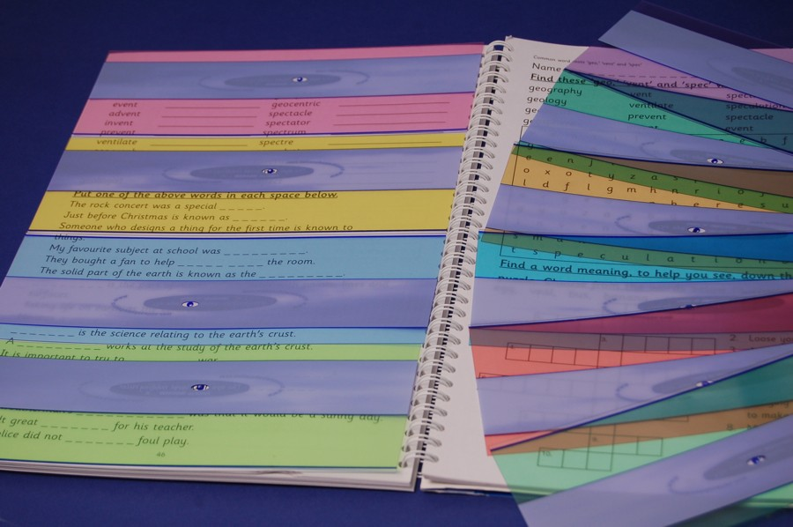
Coloured Acetate

Slide 2

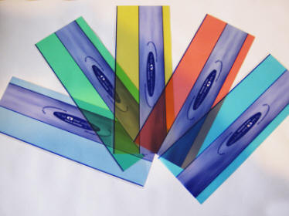

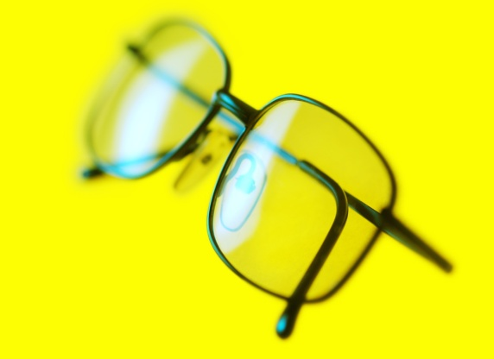
What are Coloured Overlays?
Irlen (1983) Scotopic sensitivity Syndrome or Meares-Irlen syndrome
Notes:
Coloured overlays are sheets of coloured plastic designed to be placed over a page of text whilst reading. They are designed to colour the page beneath without interfering with the clarity of the writing. There have been various assertions made about overlays from reducing visual stress and fatigue (including headaches) and most importantly increasing reading speed and fluency. Therefore they are often used with individuals with dyslexia or related reading difficulties. Coloured lenses are also used for the same purposes. This is based on the idea proposed by Meares (1980) that for some individuals the contrast of the black ink on a white paper makes reading difficult. Therefore changing this relation might result in a reduction of the symptoms associated with visual stress (Wilkins, 2003; Irlen, 2010).
Development
In 1980 Olive Meares, a school teacher discovered that her pupil’s reports of visual perceptual difficulties could be reduced by covering the page with sheets of plastic such as x-ray film, Perspex, etc. Irlen (1983) supported this notion by describing how her students reported fewer visual distortions when aided by coloured filters. Irlen went on to propose that reaction to these coloured filters constituted a disorder called Scotopic sensitivity Syndrome or Meares-Irlen syndrome whereby coloured lenses and filters reduce wave lengths and correct perceptual dysfunctions. There remains no criteria for SSS other than the reported benefit of coloured filters when reading (Handler and Fierson, 2011). She also proposed that coloured overlays would be of use to children with dyslexia.

Slide 3

How do they work?
Huang et al (2003)Cortical hypersensitivity
Chouinard et al. (2012) neuroimaging techniques found initial evidence showing cortical over-excitability in presence of visual stress syndrome.
Whether coloured overlays can reduce this visual stress remains unclear.
Notes:
Theoretical underpinnings
Huang et al. (2003) posits that visual stress is caused by strong sensorial stimulation produced by dense text that might lead to a reduction of the efficiency of the inhibitory mechanisms in the visual cortex, thus resulting in an excessive excitation of the cortical neurons, and this would cause illusions and distortions. Thereby implying that some individuals are affected by a sort of cortical hypersensitivity so that their visual cortex would overreact to intense visual stimulations thus causing the symptoms associated with visual stress. Wilkins and Evans (2010) proposed that the colored overlays are effective because they reduce this excessive excitation and therefore the symptoms of visual stress, resulting in improvements of reading. Henderson et al., (2013) propose that this idea lacks strong empirical evidence. However Chouinard et al. (2012) used neuroimaging techniques found that there is at least some initial evidence showing cortical over-excitability in presence of visual stress syndrome. Whether coloured overlays can reduce this visual stress remains unclear.

Slide 4
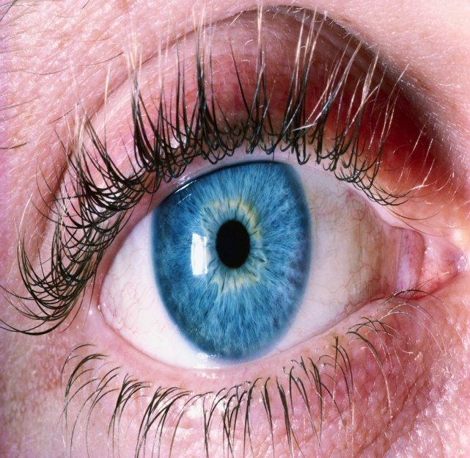
Context
Notes:
Context
The way that reading difficulties have been conceptualized historically has altered from an emphasis on visual factors to a focus on phonology. The term “word blindness” (Kusmal, 1877; Hinshelwood 1895) and the suggestion that dyslexic type behaviours were due to difficulty with visual memory for words or letters or related to letter and word reversals ((Orton, 1920) has now shifted towards a phonological hypothesis (BPS, 1999; Shankweiler & Crain, 1986; Stanovich, 1988; Snowling,1987, 1991, 1995; Frith, 1997) whereby phonological awareness and the sensitivity to the sound structure of speech is now the dominant theory. However coloured acetate appears to have its theoretical underpinnings in the visual hypothesis.

Slide 5
Evidence base
Albon, Adi and Hyde (2008) systematic review
Methodological flaws such as; small sample sizes, inadequate controls, lack of reporting of randomisation methods, difficulty in the maintenance of any blinding, high levels of attrition and selection bias
Meta-analysis-reading speed and reading comprehension (4 studies for each outcome) showed no clear benefit to using coloured filters compared to using the control.
Meta-analysis and qualitative assessment of eight included RCTs did not show that the use of coloured filters led to a clear improvement in reading ability in subjects with reading disability.
No major implications for current practice
Possibility of subgroup
Notes:
Evidence
Albon, Adi and Hyde (2008) conducted a systematic review into the effectiveness of coloured filters for reading disability from MEDLINE, EMBASE, CINAHL, PsychINFO, Science Citation Index and the Cochrane Library databases. Studies were included if they involved tinted or coloured lenses, glasses, or overlays and subjects had a reading disability and were aged 7 years or over. One quasi-systematic review and eight RCTs were included in the review of effectiveness of coloured filters for reading disability. The review proposed that there were many methodological flaws such as; small sample sizes, inadequate controls, lack of reporting of randomisation methods, difficulty in the maintenance of any blinding, and high levels of attrition. A further design flaw was identified in five studies demonstrated selection bias whereby the sample where already selected as they had shown some improvement with use of coloured overlays. Meta-analysis for the outcome of reading accuracy (3 studies), reading speed and reading comprehension (4 studies for each outcome) showed no clear benefit to using coloured filters compared to using the control. The results of the meta-analysis should be treated with caution since the trial design, patient characteristics and outcome tests varied considerably between studies. Two studies evaluated the visual stress that can be associated with reading disability and found coloured filters to be effective however both studies used subjective measures. The long-term effects of using coloured filters were not evaluated. Meta-analysis and qualitative assessment of eight included RCTs did not show that the use of coloured filters led to a clear improvement in reading ability in subjects with reading disability. They argue that based on the evidence obtained from this systematic review there can be no major implications for current practice in the treatment of reading disability. They suggest that it remains a possibility that there exists a subgroup of people who may experience an improvement in reading through the use of coloured filters, while others find that there is no beneficial effect.

Slide 6
Evidence base
American Academy of Pediatrics (AAP) (2011) in a review examining learning disabilities, dyslexia and vision
Little evidence of SSS and question its existence.
Methodological flaws of the research including small sample size, biased selection of sample, lack of control group, subject attrition and a reliance on anecdotal evidence over quantifiable evidence of improved reading ability.
They conclude that they do not advocate the use of visual treatments for reading as the evidence base is questionable suggest that phonological interventions are more effective.
Notes:
American Academy of Pediatrics (AAP) (2011) in a review examining learning disabilities, dyslexia and vision they conclude that there is very little evidence of SSS and question its existence. They discuss methodological flaws of the research including small sample size, biased selection of sample, lack of control group, subject attrition and a reliance on anecdotal evidence over quantifiable evidence of improved reading ability. They conclude that they do not advocate the use of visual treatments for reading as the evidence base is questionable due to methodological flaws and suggest that phonological interventions are more effective.

Slide 7
Evidence base
Uccula, Enna and Mulatti (2014) (online publication) conducted a critical review of the literature.
Acknowledge methodological flaws -but reject the AAP’s (2009) suggestion that this means that we should not recommend overlays but instead suggest that more rigorous research be conducted.
Successful in certain populations and not others
Notes:
Uccula, Enna and Mulatti (2014) (online publication) conducted a critical review of the literature. They suggest that the evidence for visual stress syndrome as an independent disorder is insufficient and the likelihood is that it is more likely a sub-type of dyslexia. They also propose that it is most likely a symptom rather than a cause of the difficulty. They acknowledge the methodological flaws of previous research suggesting that coloured overlays are effective but reject the AAP’s (2009) suggestion that this means that we should not recommend overlays but instead suggest that more rigorous research be conducted. They report that it is not a definitive issue that coloured overlays do not work but that the findings to date have been insufficient and inconclusive due to it being successful in certain populations and not others. For example the efficacy of overlays is not well supported in studies that use adults (Henderson et al. 2013) or non-dyslexic children (Ritchie et al. 2011; Ritchie et al. 2012) however when the sample used are children with dyslexia the effect is observed more easily (Singleton and Trotter, 2005; Singleton and Henderson, 2007)

Slide 8
Evidence base
Galuschka K, Ise E, Krick K, Schulte-Körne G. (2014) meta-analysis of RCTs into the effectiveness of treatment approaches for children and adolescents with reading disabilities
Phonics interventions were the only approach that significantly improved reading and spelling performance in children with reading disabilities.
The mean effect sizes of the remaining treatment approaches including coloured overlays or lenses did not reach statistical significance.
More blind RCTs.
Notes:
Galuschka K, Ise E, Krick K, Schulte-Körne G. (2014) conducted a meta-analysis of RCTs into the effectiveness of treatment approaches for children and adolescents with reading disabilities using ERIC, PsycINFO, PubMed, and Cochrane databases. They included twenty-two RCTs with a total of 49 comparisons of experimental and control groups. The comparisons evaluated five reading fluency trainings, three phonemic awareness instructions, three reading comprehension trainings, 29 phonics instructions, three auditory trainings, two medical treatments, and four interventions with coloured overlays or lenses. One trial evaluated the effectiveness of sunflower therapy and another investigated the effectiveness of motor exercises. They found that phonics interventions were the only approach that significantly improved reading and spelling performance in children with reading disabilities. The mean effect sizes of the remaining treatment approaches including coloured overlays or lenses did not reach statistical significance. They also identified the need for more blind RCTs.

Slide 9
Conclusion and Implications
Not a strong rigorous evidence base to support use of coloured overlays due to quality of current research (more blind RCTs required)
Henderson and Taylor (2014) challenged dyslexia charities to acknowledge opposing evidence
More understanding required for the proposed processes of how it works
More understanding of visual stress, whether it is a separate syndrome from dyslexia and whether it impacts on reading
Anecdotal evidence in support of reducing visual stress/Subtype?
Phonics instruction to be emphasised over visual therapies
Notes:
There have been many reviews into the research surrounding the efficacy of coloured overlays to aid reading in terms of visual stress, reading fluency and comprehension. The majority of the reviews conclude that the current research has serious methodological flaws which bring into question the validity of their claims. They all suggest that more rigorous research with larger samples, a non-biased approach to sample selection, use of blind RCTs and investigations into the possible placebo effect are needed to improve the quality of research. The way that they vary in their conclusions is the extent to which they recommend or reject the use of coloured overlays based on this claim. More research and understanding into the processes that are supposed to underpin its efficacy are also necessary. Henderson and Taylor (2014) called upon dyslexia charities to present a more balanced view of the research evidence as they claim that many dyslexia charities in the UK are currently promoting coloured overlays without acknowledging the opposing findings in the evidence base. Further research is needed to identify if there is indeed a link between visual stress and reading difficulties and whether it constitutes a distinct syndrome (SSS). Anecdotal evidence in support of reducing visual stress/Subtype?
Phonics instruction to be emphasised over visual therapies

